Slide 1

CATALOGUED PROCEDURE WITH
SYMBOLIC PARAMETERS
PRESENTED BY
P.L.KRISHNA KANTH

Slide 2
Catalogued Procedure
When the procedure is separated out from the JCL and coded in a different data store, it is called a Catalogued Procedure.
A PROC statement is not mandatory to be coded in a catalogued procedure.

Slide 3
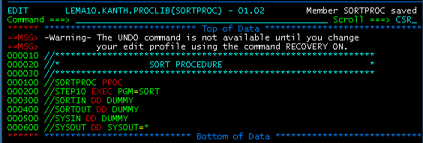
Procedure Sort

Slide 4
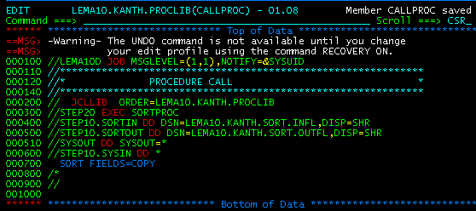
Procedure Call

Slide 5
Symbolic Parameters
It is a character string of 1 to 7 Alphanumeric characters preceded by an ampersand (&). The first character after & must be alphabetic.
When a cataloged procedure is processed each symbolic parameter is either assigned a value or nullified.
This can be done with the EXEC PROC (for defining or passing values).

Slide 6
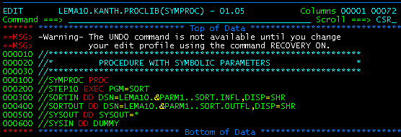
Procedure with symbolic parameters

Slide 7
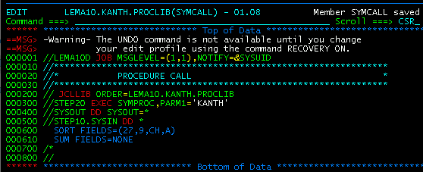
Procedure Call

Slide 8
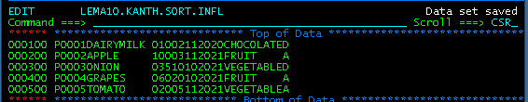
Sort – Discard Duplicates
Example:
Performing sort to delete the duplicate records
From product category
Input File:

Slide 9
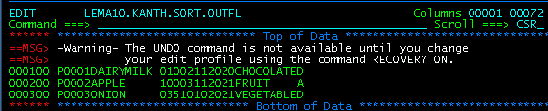
Output File:

Slide 10



Thank you
Reimagine technology to
accelerate your business
www.htcinc.com
www.caretech.com
www.ciber.com

